Slide 1
SCOPE 2017
Colin Wharton, Olivia McGowan,
Abby knox, David Thomas

Slide 3
Debate #1
The ACT shall be substituted for end of course exams.
Student Congress Results:
31% AGREE
69% DISAGREE

Slide 4
Debate #2
All high schools shall offer at least 20% of classroom instruction online.
Student Congress Results:
69% AGREE
31% DISAGREE

Slide 5
Debate #3
Every student shall have an
Individual Education Program (IEP).
Student Congress Results:
50% AGREE
50% DISAGREE

Slide 6
Debate #4
A student discipline council shall be organized to handle minor student offenses.
Student Congress Results:
20% AGREE
80% DISAGREE

Slide 7
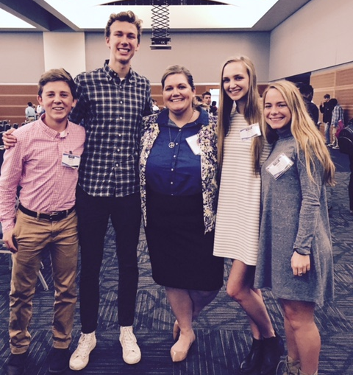
Thank you School Board Members!

